Slide 1

"Electronics is clearly the winner of the day." — John Ford
Instrumentation and Control
CSE 325
Mehedi Hasan
Lecturer
Computer Science and Engineering(CSE)
Daffodil International University(DIU)

Slide 2
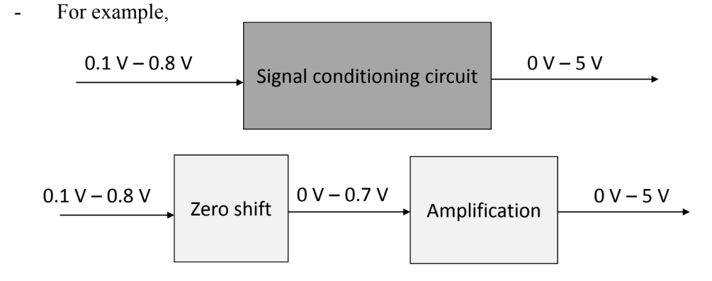
Change of signal level – getting the level of the signal right
It means adjusting the level (magnitude) and bias (zero value) of signal
The signal might be just a few milivolts. To feed the signal into an A/D converter for inputting to a microprocessor, it needs to be made much larger; volts rather than milivolts. Operational amplifier circuits are widely used for amplification.

Slide 3
Introduction
An amplifier is a device that amplifies a signal – almost always a voltage
The low voltage output of a sensor, say of a thermocouple, may be amplified to a level required by a controller or a display.
Amplification may be quite large – sometimes of the order of 10⁶ or it may be quite small or even smaller than one, depending on the need of the sensor.
Amplifiers can also be used for impedance matching purposes even when no amplification is needed.
Power amplifiers, which usually connect to actuators, provides the power necessary to drive them.
Amplifiers are sometimes incorporated in the sensor.

Slide 4
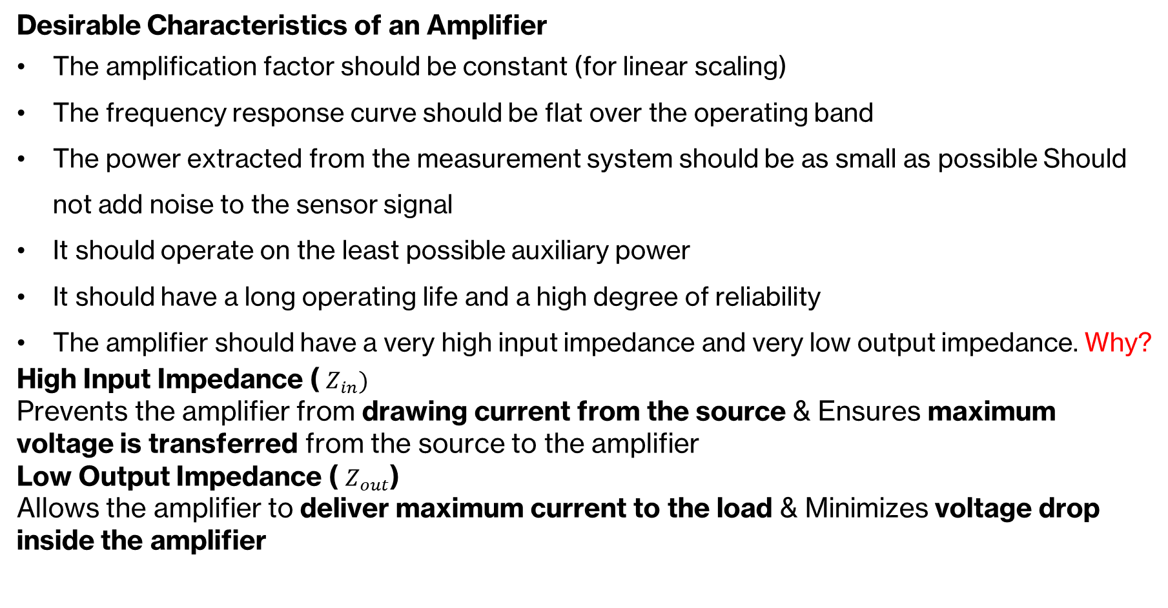
Amplifiers for Instrumentation

Slide 5
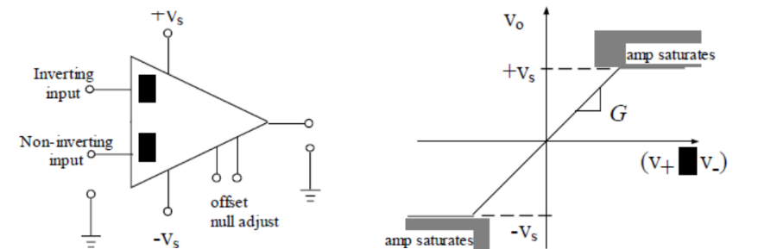
Amplifiers for Instrumentation
Almost always, operational amplifiers (Op-amp) are used for amplification, as they have almost all the desirable characteristics mentioned earlier.
Very high gain, more than 10^6, ideally infinite
Adjustable gain can be achieved by external circuit element
High input impedance (ideally infinite) and low output impedance (ideally zero, practical values 20-100 Ω)

Slide 6
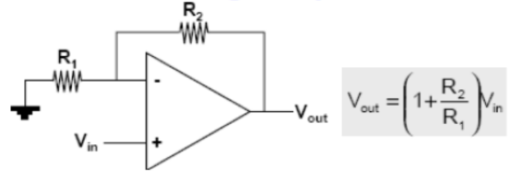
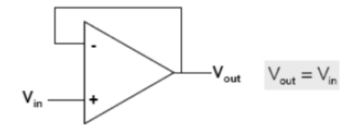
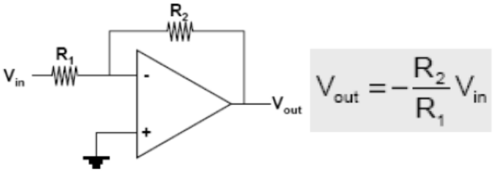
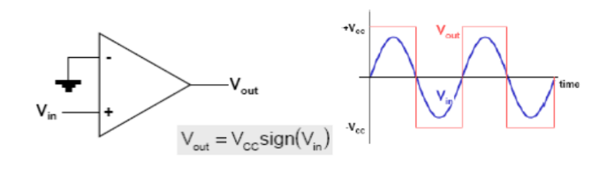
Circuit Configurations Using Op-Amps
Non-Inverting Operational Amplifier (Op-Amp)
Voltage Follower (Buffer Amplifier)
Inverting Operational Amplifier (Op-Amp)
Voltage Comparator (Op-Amp Comparator)

Slide 7
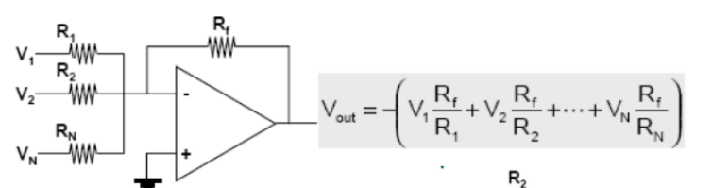
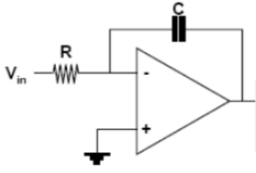

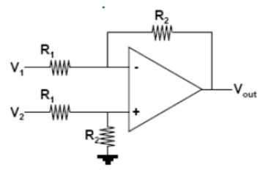
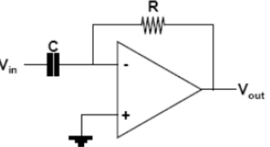

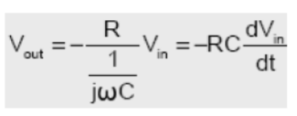
Circuit Configurations Using Op-Amps
Summing Amplifier
Integrating Amplifier (Integrator)
Differential Amplifier
Differentiating Amplifier (Differentiator)

Slide 8
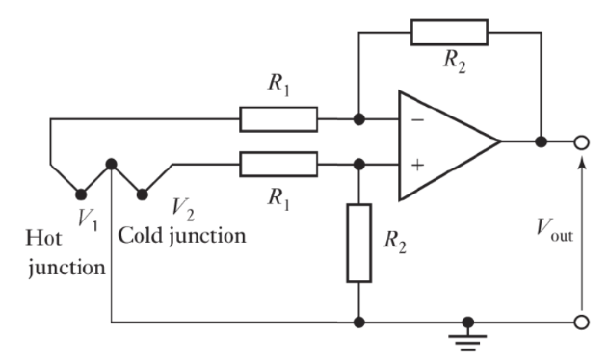
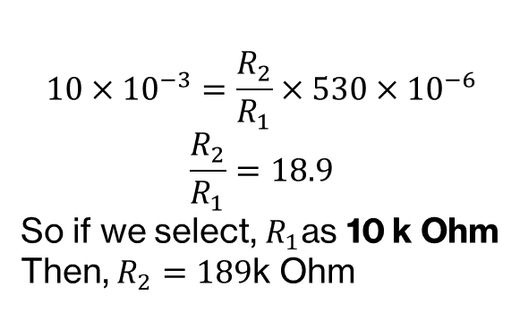
Circuit Configurations Using Op-Amps
Example: The difference in the emfs of the two junctions of the thermocouple is being amplified. A temperature difference of 10 °C produces an emf difference of 530 μV. then the values of R1 and R2 can be chosen to give a circuit with an output of 10 mV.

Slide 9
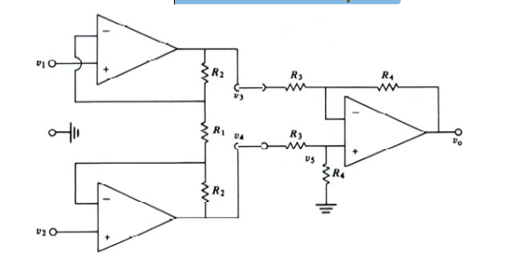

Instrumentation Amplifier
It is available in single IC and is designed to have:
Very high input impedance (300 MΩ), very low output impedance
High common-mode rejection ratio (more than 100 dB)
High voltage gain

Slide 10
Math
Example & Practice Problem : 5.3, 5.5, 5.6, 5.7, 5.8.
Book: Fundamentals of Electrical circuits
Charles K.Alexander
Matthew N.O. Sadiku
Page: 182 to 190

Slide 11
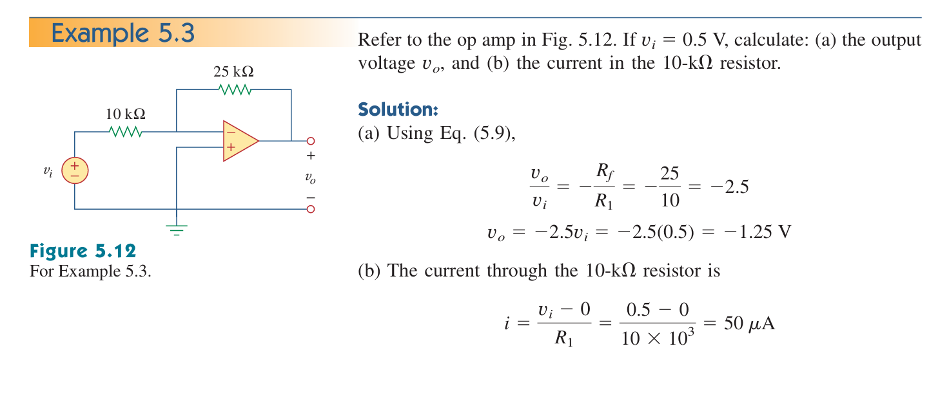

Slide 12
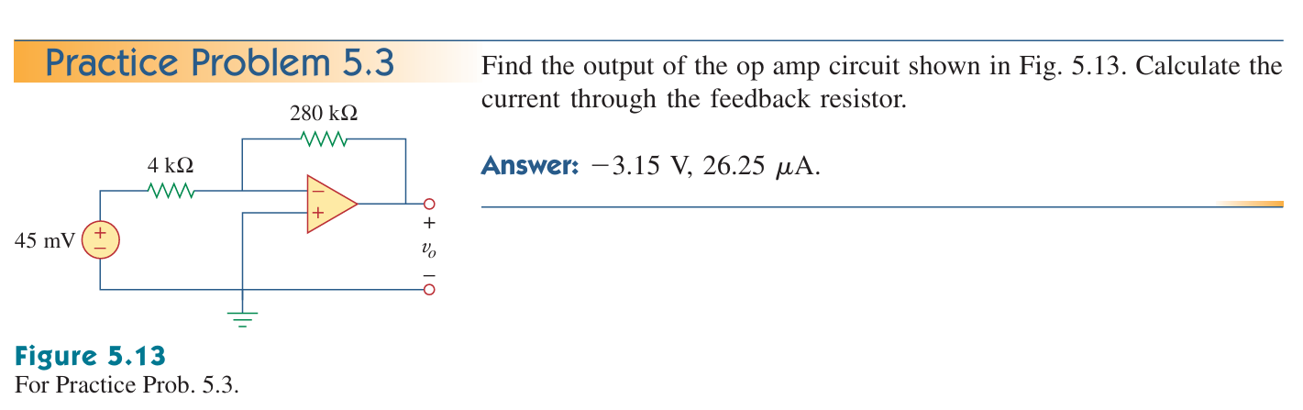

Slide 13
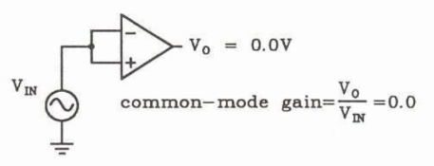
Operational Amplifier- Properties
Differential voltage gain (A_{d}):
- the amplification of the op-amp of the difference between the two inputs.
- also called the open loop gain
- in a good amplifier it should be as high as possible.
- gains of 10^6 or higher are common.
An ideal amplifier is said to have infinite gain.
Common-mode voltage gain (A_{cm}):
- By virtue of differential nature of the amplifier, this gain should be zero.
- Practical amplifiers may have a small common mode gain because of the mismatch between the two channels but this should be small.

Slide 14
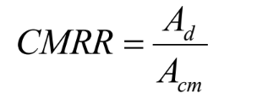
Operational Amplifier- Properties
CMRR (Common Mode Rejection Ratio (CMRR)) is the ratio between A_{d} and A_{cm}:
It can also be expressed in dB
➢
In an ideal amplifier this is infinite.
A good amplifier will have a CMRR that is very high

Slide 15
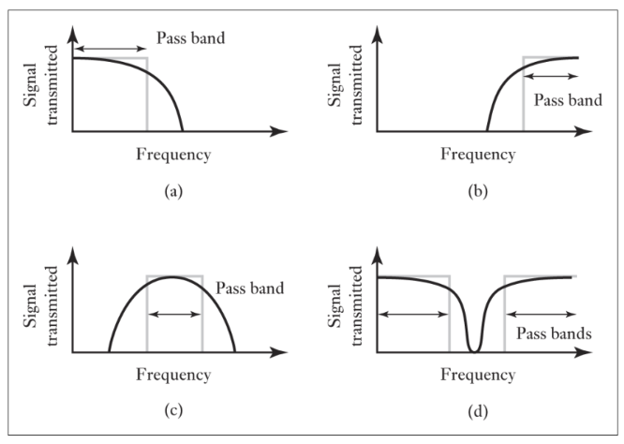
Eliminating or reducing noise – increasing the signal-to-noise ratio (SNR)
Noise may come from:
➢ Inherent noise (Internal to the sensor)
➢ Interference (external): main source of noise
Filter or compensation circuits might be used to eliminate or reduce noise from a signal
Example filters:
(a) low-pass
(b) high-pass
(c) Band-pass
(d) Band-stop (notch filters)

Slide 16
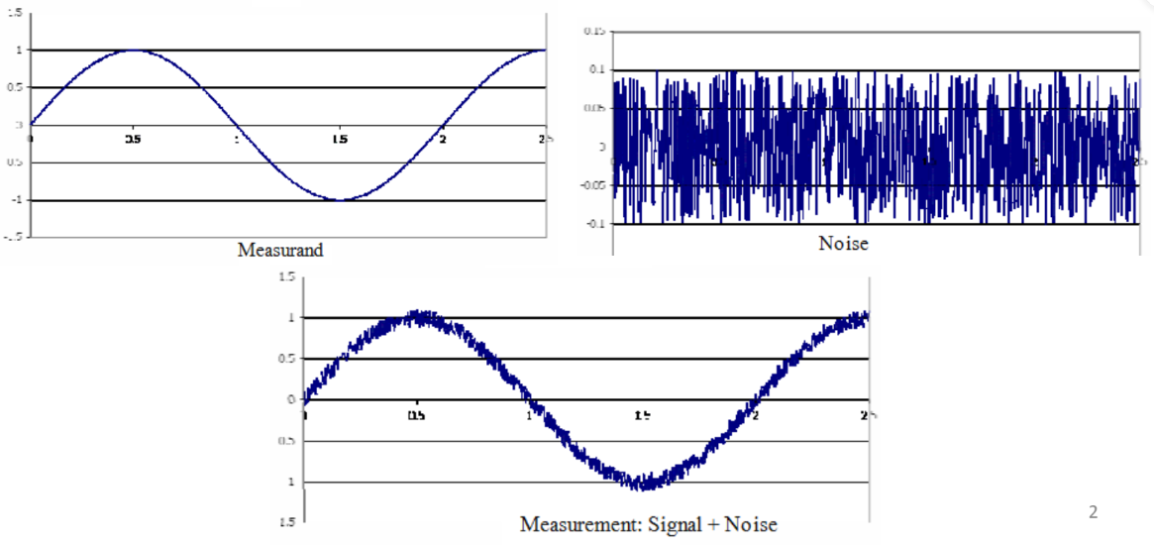
Noise : Introduction
Noise is a variation in the measurement of a variable that does not reflect real changes in the variable.
Noise may come from different sources. Whatever the source, noise distorts the original signal

Slide 17
Effects of Noise
Effects of Noise
Reduces precision, accuracy (sometimes) and resolution of the measurement.
Introduces errors in control systems: To a controller, fluctuation in the process variable caused by noise are indistinguishable from fluctuations caused by real variable. Noise in a process variable will be reflected in the output of the controller.
Types and Sources of Noise
Many sources and many types of noise but it can be distinguished between two broad types
1. INTERNAL: Noise internal to a sensor/amplifier/circuit
2. EXTERNAL: Interference noise (external).

Slide 18
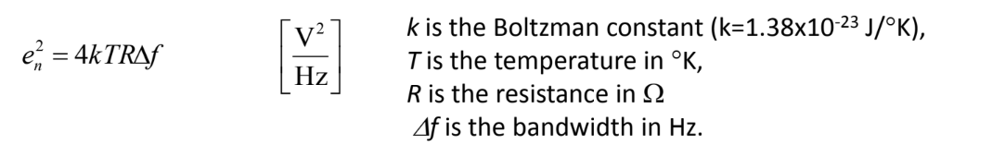
Internal Noise
Internal noise is generated due to many effects in the circuit elements. Some of them are avoidable, but some are intrinsic.
a) Thermal or Johnson noise
b) Shot noise
c) Pink noise
Thermal or Johnson noise:
One of the basic sources of the noises is the resistor R.
Causes: This is generated due to the chaotic thermal movement of the charges.
The noise power density is given by:
Solution:
Can be reduced by the decrease of R, by limiting of bandwidth and of course by control of temperature.
Fairly constant over wide range of frequencies. So, it is called a WHITE NOISE

Slide 19
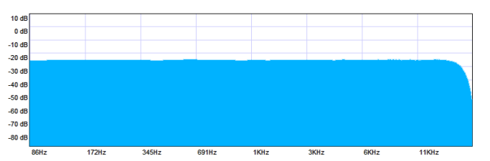
WHITE NOISE
A white noise is a random signal with constant power spectral density over the entire frequency range.

Slide 20
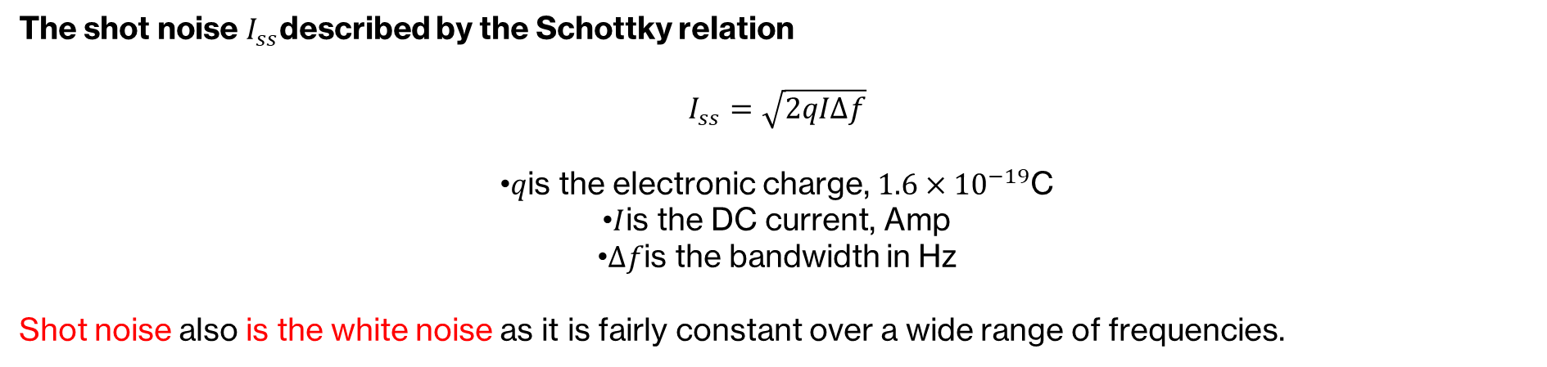
Internal Noise
Shot noise:
This type of noise is produced in electronic/photonic devices with semiconductor junctions.
Causes: Produced in semiconductors when charges flows past the potential barrier by random collisions of electrons and atoms that causes fluctuations in the real signal current.

Slide 21
Internal Noise
Pink noise:
These are 1/f type noises (sometimes called low frequency noise, flicker noise or excess noise), as they are inversely proportional to the frequency.
So, unlike white noise, this type of noise has higher energy at low frequencies.
This is a problem for the sensors that operate at low frequencies.
There are many sources of these noises, most of them unknown.

Slide 22
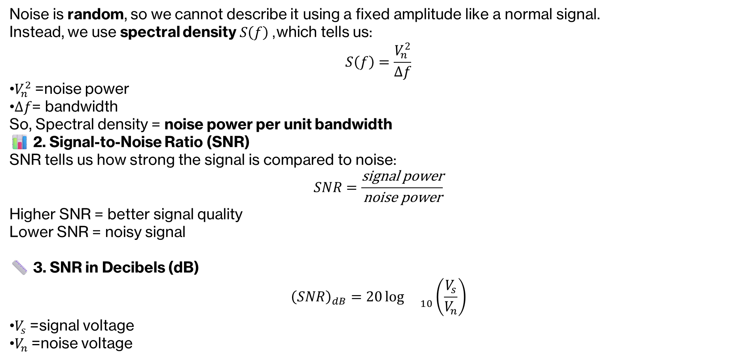
Noise Evaluation

